Slide 1
LECTURE 3. BILATERAL DIPLOMACY; OBJECTIVES, MEANS AND INSTRUMENTS
International Policy and Diplomacy of Kazakhstan, PDRKMS 4306
By Marem Buzurtanova
Almaty 2021 - 2022

Slide 2
LECTURE 3. BILATERAL DIPLOMACY; OBJECTIVES, MEANS AND INSTRUMENTS
Topics to Be Covered:
History of Diplomacy;
Relations between bilateral diplomacy and multilateral diplomacy;
Establishment of diplomatic relations and its implications for a state;
International legal framework for Diplomatic agents and Diplomatic immunity;
Objectives, means and instruments of diplomacy.

Slide 3
LECTURE 3. BILATERAL DIPLOMACY; OBJECTIVES, MEANS AND INSTRUMENTS
History of Diplomacy;
the actual term ‘diplomacy’ did not enter into usage until the last decade of the 18th century;
diplomatic practices existed across the human experience, spanning the globe and going back before recorded history;
‘diplomacy’ s understood today was born out of Western revolution and enlightenment;
‘diplomacy’ has been historically associated with the state;
diplomacy as communication, representation and influence.

Slide 4
LECTURE 3. BILATERAL DIPLOMACY; OBJECTIVES, MEANS AND INSTRUMENTS
History of Diplomacy:
in prehistoric times, when tribes were at war, they had to pick up the wounded and bury the dead, hens negotiations were held and certain privileges and immunities of negotiators emerged.
slave-owning empires constantly use military means of foreign policy. Diplomatic communication were sporadic, embassies with a specific missions returned after it was completed.
in medieval times, "private" diplomats of feudal sovereigns concluded peace treaties, entered into military alliances, and arranged dynastic marriages …

Slide 5
LECTURE 3. BILATERAL DIPLOMACY; OBJECTIVES, MEANS AND INSTRUMENTS
Diplomacy Old and New
The First World War and the events after were the borderline in the development of diplomacy: Woodrow Wilson ‘s 14 points, the abolition by Soviet Russia of "enslaving treaties" and the rejection of secret diplomacy; the League of Nations and International Court; increasing role media and their influence on international politics.

Slide 6
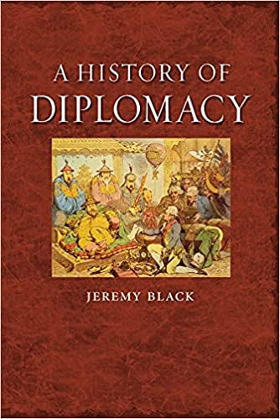
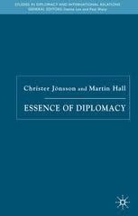
LECTURE 3. BILATERAL DIPLOMACY; OBJECTIVES, MEANS AND INSTRUMENTS
History of Diplomacy;
Black, J. (2010). A history of diplomacy. Reaktion Books.
Jönsson, C., & Hall, M. (2005). Essence of diplomacy. Springer. https://www.researchgate.net/profile/Martin-Hall-4/publication/268051590_The_Essence_of_Diplomacy/links/54eeed210cf2e2830865c0c0/The-Essence-of-Diplomacy.pdf

Slide 7
LECTURE 3. BILATERAL DIPLOMACY; OBJECTIVES, MEANS AND INSTRUMENTS
Relations between bilateral diplomacy and multilateral diplomacy;
Bilateral diplomacy
Multilateral diplomacy

Slide 8
LECTURE 3. BILATERAL DIPLOMACY; OBJECTIVES, MEANS AND INSTRUMENTS
Establishment of diplomatic relations and its implications for a state;
Diplomatic relations are a form of official relations between sovereign states, as well as between states and other subjects of public international law in accordance with the norms of international law and the practice of international communication;
According to the Vienna Convention on Diplomatic Relations (1961), the establishment of DR takes place by mutual consent (2) and usually preceded by the recognition of the state and government, preferably with opening of a diplomatic mission or, better still, their exchange.

Slide 9
LECTURE 3. BILATERAL DIPLOMACY; OBJECTIVES, MEANS AND INSTRUMENTS
International legal framework for Diplomatic agents and Diplomatic immunity:
VIENNA CONVENTION ON DIPLOMATIC RELATIONS AND OPTIONAL PROTOCOLS
Article I
For the purpose of the present Convention, the following expressions shall have the meanings hereunder assigned to them:
(a) the "head of the mission" is the person charged by the sending State with the duty of acting in that capacity;
(b) the "members of the mission" are the head of the mission and the members of the staff of the mission;
(c) the "members of the staff of the mission" are the members of the diplomatic staff, of the administrative and technical staff and of the service staff of the mission;
(d) the "members of the diplomatic staff" are the members of the staff of the mission having diplomatic rank;
(e) a "diplomatic agent" is the head of the mission or a member of the diplomatic staff of the mission;
(f) the "members of the administrative and technical staff" are the members of the staff of the mission employed in the administrative and technical service of the mission;
(g) the "members of the service staff" are the members of the staff of the mission in the domestic service of the mission;
(h) a "private servant" is a person who is in the domestic service of a member of the mission and who is not an employee of the sending State;
(i) the "premises of the mission" are the buildings or parts of buildings and the land ancillary thereto, irrespective of ownership, used for the purposes of the mission including the residence of the head of the mission.

Slide 10
LECTURE 3. BILATERAL DIPLOMACY; OBJECTIVES, MEANS AND INSTRUMENTS
International legal framework for Diplomatic agents and Diplomatic immunity (Vienna Convention):
Article 3
1. The functions of a diplomatic mission consist inter alia in:
(a) representing the sending State in the receiving State;
(b) protecting in the receiving State the interests of the sending State and of its nationals, within the limits permitted by international law;
(c) negotiating with the Government of the receiving State;
(d) ascertaining by all lawful means conditions and developments in the receiving State, and reporting thereon to the Government of the sending State;
(e) promoting friendly relations between the sending State and the receiving State, and developing their economic, cultural and scientific relations.

Slide 11
LECTURE 3. BILATERAL DIPLOMACY; OBJECTIVES, MEANS AND INSTRUMENTS
International legal framework for Diplomatic agents and Diplomatic immunity (Vienna Convention):
Article 9
1. The receiving State may at any time and without having to explain its decision, notify the sending State that the head of the mission or any member of the diplomatic staff of the mission is persona non grata or that any other member of the staff of the mission is not acceptable. In any such case, the sending State shall, as appropriate, either recall the person concerned or terminate his functions with the mission. A person may be declared non grata or not acceptable before arriving in the territory of the receiving State.

Slide 12
LECTURE 3. BILATERAL DIPLOMACY; OBJECTIVES, MEANS AND INSTRUMENTS
International legal framework for Diplomatic agents and Diplomatic immunity (Vienna Convention):
Article 14
1. Heads of mission are divided into three classes, namely:
(a) that of ambassadors or nuncios accredited to Heads of State, and other heads of mission of equivalent rank;
(b) that of envoys, ministers and internuncios accredited to Heads of State;
(c) that of charges d'affaires accredited to Ministers for Foreign Affairs.
Article 15
The class to which the heads of their missions are to be assigned shall be agreed between States.

Slide 13
LECTURE 3. BILATERAL DIPLOMACY; OBJECTIVES, MEANS AND INSTRUMENTS
International legal framework for Diplomatic agents and Diplomatic immunity (Vienna Convention):
Article 22
1. The premises of the mission shall be inviolable. The agents of the receiving State may not enter them, except with the consent of the head of the mission.
2. The receiving State is under a special duty to take all appropriate steps to protect the premises of the mission against any intrusion or damage and to prevent any disturbance of the peace of the mission or impairment of its dignity.
3. The premises of the mission, their furnishings and other property thereon and the means of transport of the mission shall be immune from search, requisition, attachment or execution.
Article 24
The archives and documents of the mission shall be inviolable at any time and wherever they may be.

Slide 14
LECTURE 3. BILATERAL DIPLOMACY; OBJECTIVES, MEANS AND INSTRUMENTS
International legal framework for Diplomatic agents and Diplomatic immunity (Vienna Convention):
Article 27
2. The official correspondence of the mission shall be inviolable. Official correspondence means all correspondence relating to the mission and its functions.
3. The diplomatic bag shall not be opened or detained.
4. The packages constituting the diplomatic bag must bear visible external marks of their character and may contain only diplomatic documents or articles intended for official use.

Slide 15
LECTURE 3. BILATERAL DIPLOMACY; OBJECTIVES, MEANS AND INSTRUMENTS
International legal framework for Diplomatic agents and Diplomatic immunity;
diplomatic agent is an agent employed by a state in its diplomatic service or in its intercourse or negotiation with other states.
Article 29
The person of a diplomatic agent shall be inviolable… not be liable to any form of arrest or detention…
Article 31
1. A diplomatic agent shall enjoy immunity from the criminal jurisdiction of the receiving State… from its civil and administrative jurisdiction, except in the case of:
(a) a real action relating to private immovable property situated in the territory of the receiving State, unless he holds it on behalf of the sending State for the purposes of the mission;
(b) an action relating to succession in which the diplomatic agent is involved as executor, administrator, heir or legatee as a private person and not on behalf of the sending State;
(c) an action relating to any professional or commercial activity exercised by the diplomatic agent in the receiving State outside his official functions.
2. A diplomatic agent is not obliged to give evidence as a witness.
3. No measures of execution may be taken in respect of a diplomatic agent except in the cases coming under sub-paragraphs (a), (b) and (c) of paragraph 1 of this Article…
4. The immunity of a diplomatic agent from the jurisdiction of the receiving State does not exempt him from the jurisdiction of the sending State.
Article 32
1. The immunity from jurisdiction of diplomatic agents may be waived by the sending State…

Slide 16
LECTURE 3. BILATERAL DIPLOMACY; OBJECTIVES, MEANS AND INSTRUMENTS
International legal framework for Diplomatic agents and Diplomatic immunity (Vienna Convention):
Article 48
The present Convention shall be open for signature by all States Members of the United Nations or of any of the specialized agencies or Parties to the Statute of the International Court of Justice, and by any other State invited by the General Assembly of the United Nations to become a Party to the Convention, as follows: until 31 October 1961 at the Federal Ministry for Foreign Affairs of Austria and subsequently, until 31 March 1962, at the United Nations Headquarters in New York.

Slide 17
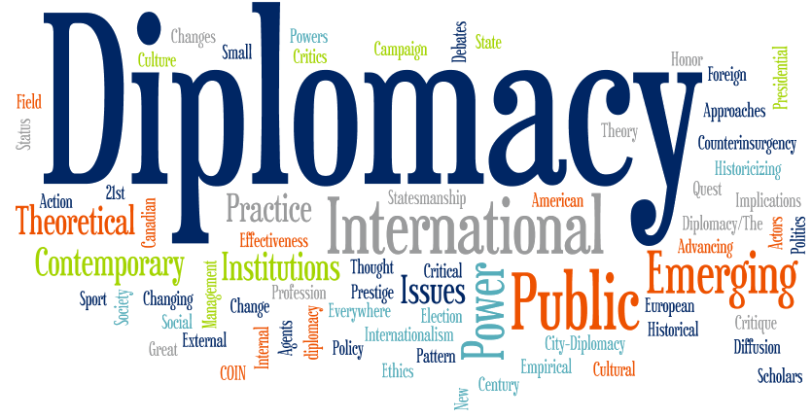
LECTURE 3. BILATERAL DIPLOMACY; OBJECTIVES, MEANS AND INSTRUMENTS
Objectives, means and instruments of diplomacy:
communication, representation \ influence

Slide 18
Full powers
Vienna convention on the law of treaties ARTICLE 7 FULL POWERS
1. A PERSON IS CONSIDERED AS REPRESENTING A STATE FOR THE PURPOSE OF ADOPTING OR AUTHENTICATING THE
TEXT OF A TREATY OR FOR THE PURPOSE OF EXPRESSING THE CONSENT OF THE STATE TO BE BOUND BY A TREATY IF:
(A) HE PRODUCES APPROPRIATE FULL POWERS; OR
(B) IT APPEARS FROM THE PRACTICE OF THE STATES CONCERNED OR FROM OTHER CIRCUMSTANCES THAT THEIR
INTENTION WAS TO CONSIDER THAT PERSON AS REPRESENTING THE STATE FOR SUCH PURPOSES AND TO DISPENSE WITH FULL POWERS.
2. IN VIRTUE OF THEIR FUNCTIONS AND WITHOUT HAVING TO PRODUCE FULL POWERS, THE FOLLOWING ARE
CONSIDERED AS REPRESENTING THEIR STATE:
(A) HEADS OF STATE, HEADS OF GOVERNMENT AND MINISTERS FOR FOREIGN AFFAIRS, FOR THE PURPOSE OF PERFORMING ALL ACTS RELATING TO THE CONCLUSION OF A TREATY;
(B) HEADS OF DIPLOMATIC MISSIONS, FOR THE PURPOSE OF ADOPTING THE TEXT OF A TREATY BETWEEN THE ACCREDITING STATE AND THE STATE TO WHICH THEY ARE ACCREDITED;
(C) REPRESENTATIVES ACCREDITED BY STATES TO AN INTERNATIONAL CONFERENCE OR TO AN INTERNATIONAL ORGANIZATION OR ONE OF ITS ORGANS, FOR THE PURPOSE OF ADOPTING THE TEXT OF A TREATY IN THAT CONFERENCE, ORGANIZATION OR ORGAN.

Slide 19
LECTURE 3. BILATERAL DIPLOMACY; OBJECTIVES, MEANS AND INSTRUMENTS
Functions of diplomacy:
Representation;
Communication;
Negotiation;
Intelligence;
Protecting the interests of citizens.
Methods and means of diplomacy:
official and other visits and negotiations;
diplomatic congresses, conferences, and meetings;
preparation and conclusion of bilateral and treaties.

Slide 20
LECTURE 3. BILATERAL DIPLOMACY; OBJECTIVES, MEANS AND INSTRUMENTS
Objectives, means and instruments of diplomacy.
Advantages and disadvantages of bilateral diplomacy

Slide 21
LECTURE 3. BILATERAL DIPLOMACY; OBJECTIVES, MEANS AND INSTRUMENTS
Topical Readers Available at UNIVER System:
Hocking, B. (2020). Communication and Diplomacy: Change and Continuity. In Global Diplomacy (pp. 79-96). Palgrave Macmillan, Cham.
Qin, Y. (2020). Diplomacy as relational practice. The Hague Journal of Diplomacy, 15(1-2), 165-173.
ONYEAKU, C. (2020). Diplomatic Law and Practice of Diplomacy in a New Global Environment. IRLJ, 2(3).
Unoki, K. (2019). Competition Laws, National Interests and International Relations. Routledge.
Morin, J. F., & Paquin, J. (2018). Foreign policy analysis: A toolbox. Springer.
Neack, L. (2018). Studying Foreign Policy Comparatively: Cases and Analysis. Rowman & Littlefield.
Iucu, O. (2010). Diplomacy and diplomatic functions. Manager, (11), 129-134.
Mintz, A., & DeRouen Jr, K. (2010). Understanding foreign policy decision making. Cambridge University Press.
Sharp, P. (2009). Diplomatic theory of international relations (Vol. 111). Cambridge University Press.
Breuning, M. (2007). Foreign policy analysis: A comparative introduction. Springer.
Feltham, R. (2004). Diplomatic handbook. Martinus Nijhoff Publishers.
Nazarbayev, N. A. (2007). New Kazakhstan in the new world. Kazakhstanskaya pravda, (33), 25278.
Tokayev, K. K. (2000). Foreign policy of Kazakhstan in the conditions of globalization. Almaty, Kazakhstan.
Vanderhill, R., Joireman, S. F., & Tulepbayeva, R. (2020). Between the bear and the dragon: multivectorism in Kazakhstan as a model strategy for secondary powers. International Affairs, 96(4), 975-993.
Diyarbakırlıoğlu, K., & Yiğit, S. (2014). Kazakh Multi Vector Foreign Policy in Action. Alternatives: Turkish Journal of International Relations, 13(4).

